Slide 1
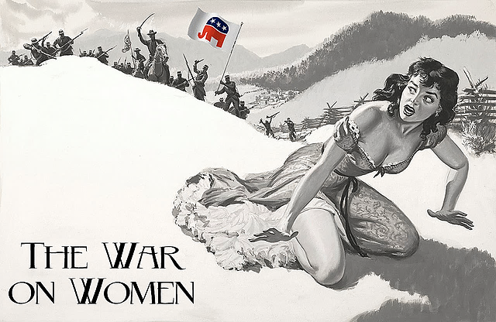
Unwaging
By: Dr. John D. Ferrer © 2016
*Image courtesy of Evette Dionne (26 July 2012)

Slide 2
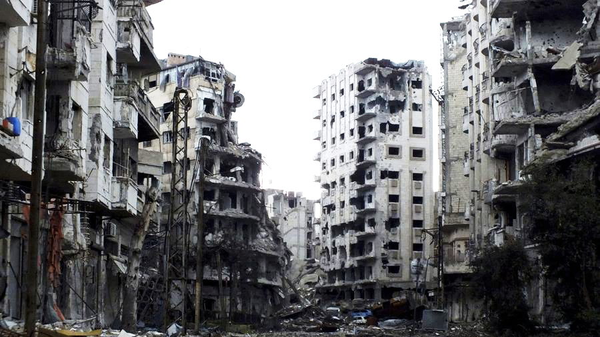
“the ‘War on Women’ is radically misconstrued such that conservatism broadly understood constitutes a crucial defense of womankind while the typically liberal feminist narrative does untold harm to women’s rights.”

Slide 3

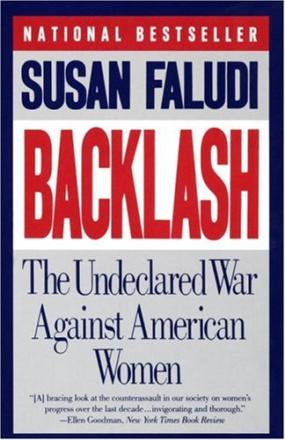
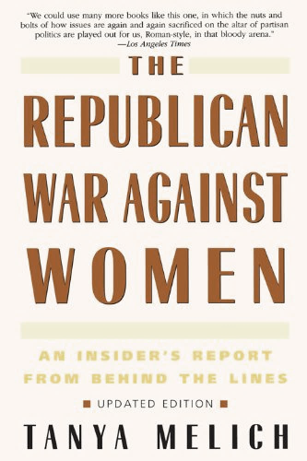


Slide 4
“Florida’s war on women”
(Salon, 9 March 2016)
”Republicans Increasingly Fret That Trump Escalates 'War on Women‘” (NBC News, 31 March 2016)
“Michican’s War on Women: by the Numbers”
(ACLU, June 2012)
“War on Women – Art show”
(Planned parenthood of Western PA, 2015)
“The War on Women: How the War on Women Became Mainstream—Turning Back the Clock in Tea Party America”
(People for the American Way/Right Wing Watch, 2010)
“Democrats redouble ‘war on women’ offensive even as phrase disappears” (Washington Times 28 July 2016)
“STOP the War on Women and Planned Parenthood”
(MoveOn.org – Rep. Diane Russel)
“The War on women is over, and women lost” (MotherJones, Sept/Oct 2015)
“Planned Parenthood shooting: America's war on women is domestic terrorism”
(the Telegraph, 1 December 2015)
“The Republican Platform’s War On Women’s Rights: What You Need To Know” (theFrisky, 28 July 2016)
“Whoa! Hillary Clinton Clobbers GOP's War On Women At Planned Parenthood” (Crooks and Liars, 11 July 2016)

Slide 5

“[the War on Women] is an expression in United States politics used to describe certain Republican Party policies as a wide-scale effort to restrict women’s rights, especially reproductive rights.”
WIKIPEDIA
The Free Encyclopedia

Slide 6
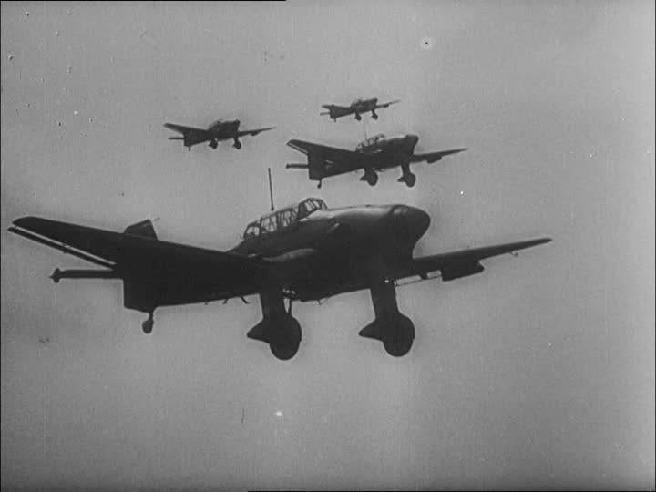
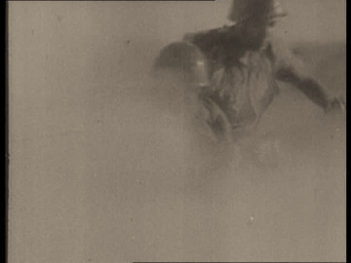
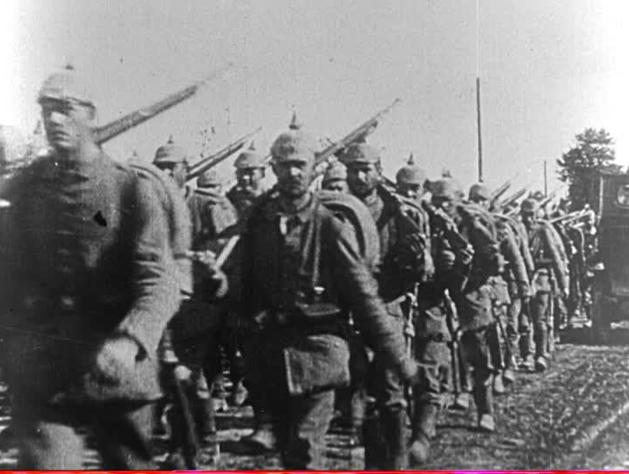
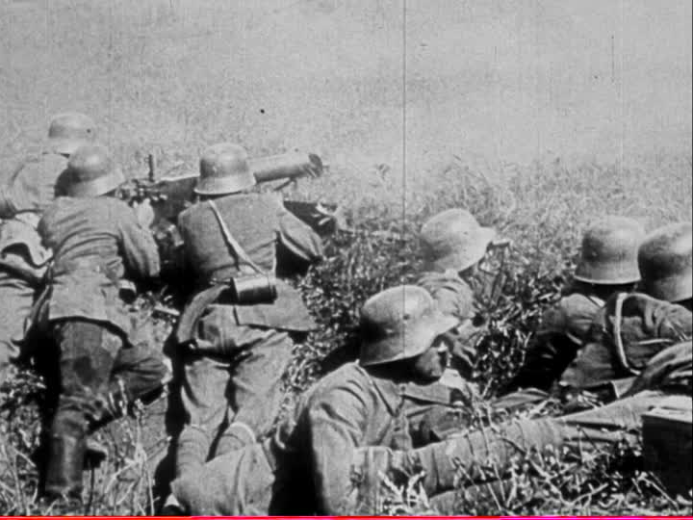
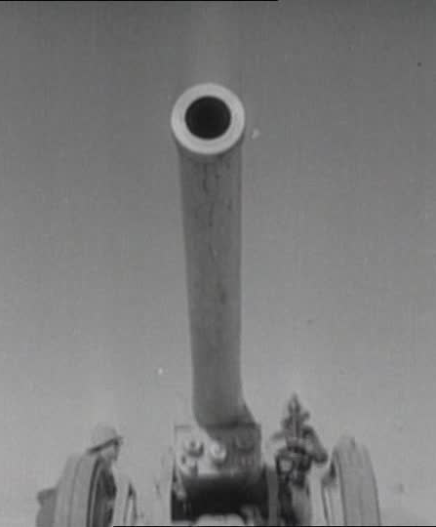
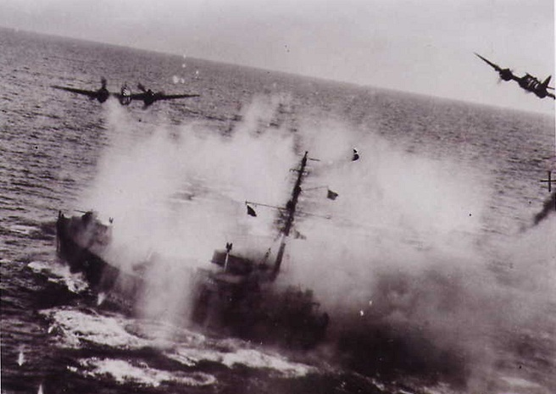

Slide 7
Violent/Life-or-death issues:
Rape/Sexual Assault
spousal abuse
sex slavery
Female Genital Mutilation
honor killings
What would a conservative “war on women” look like?

Slide 8
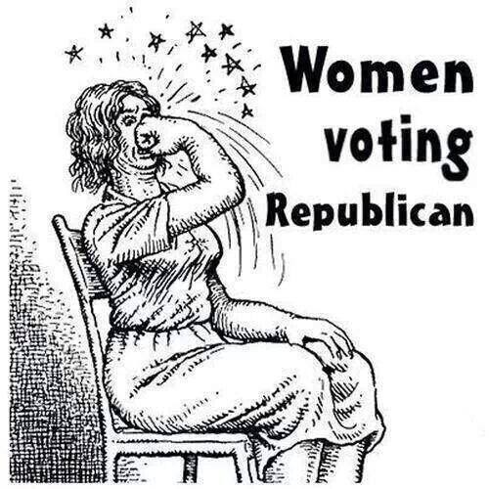
“It would be a sort of “covert ops”–
a malicious and deadly attack
conducted in the guise of “family
values.” Conservatives tactically
oppose the interests of women by
foisting unnatural and foreign
constraints on their liberty. The ‘War
on Women’ would then be violent
conservative opposition to the needs and interests of women. This is not gendercide, but it still might be patriarchal oppression harming women in untold ways.”

Slide 9
How would this war be waged?
Abortion & Contraception
In other words, “women’s health” pretty much means preventing and terminating pregnancy.

Slide 10
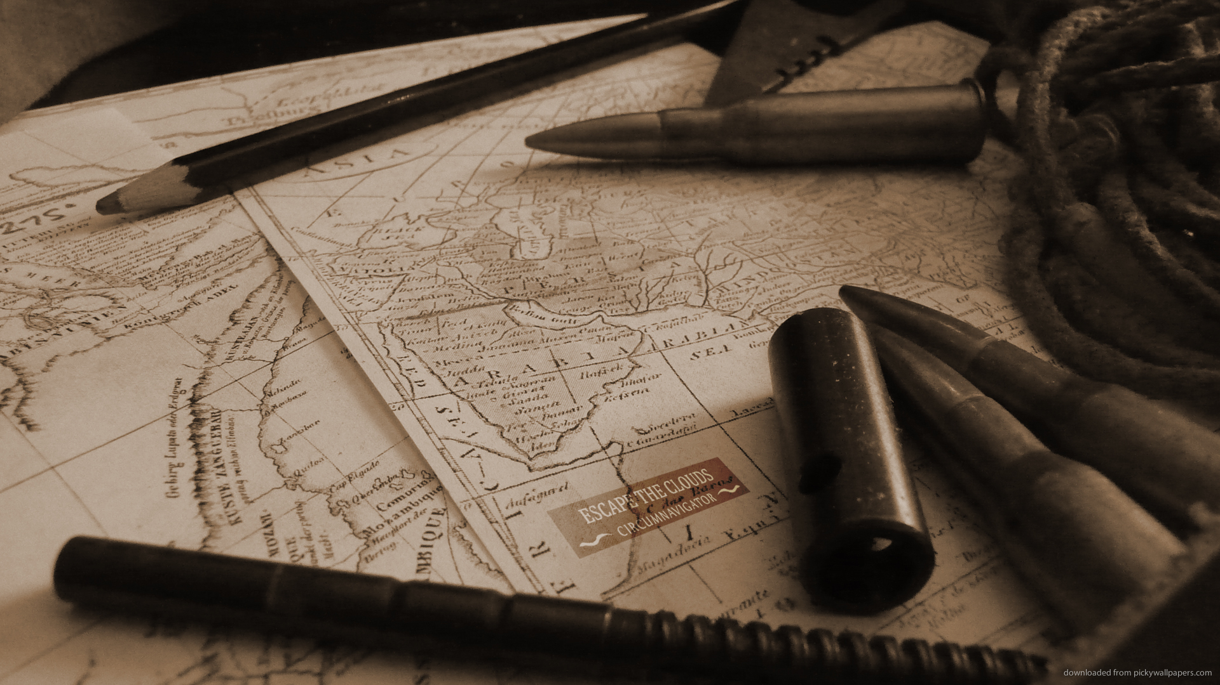
“The theater of this war is not in the straits of female psychology, in the lands of beauty and cosmetics, or in the murky waters of gender studies, but in the nether regions of sex and reproduction.”
“The “war on women,” identifies women primarily by their lady parts, autonomous vaginas and uteri more than as minds or persons, and especially not as people who might vote Republican.”

Slide 11
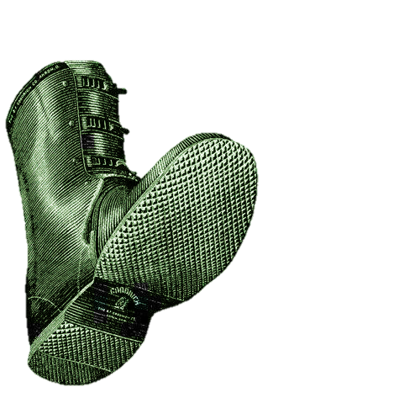
What Motivates This War?
“…Oppression. Conservatives apparently want to subjugate women in archaic molds: property, baby-makers, or punching bags.”

Slide 12
“That “war on women” narrative does not describe conservatism; it is propaganda. . . . It errs on several levels
It’s “The Boy Who Cried Wolf”
It’s a Narrow view of Femininity (Egalitarian vs. Maternal)
It’s Special Pleading/Cherry Picking
It’s Overly Divisive
It’s a Caricature/Straw-Man
It’s Distracts from real violence
It cuts the other way

Slide 13
Women are harmed when . . .
Liberal Feminism Militates Against Maternity.
Abortion Has Killed 30 million females since 1973
They’re taught that they “need” abortion-access to be equal with men.
“masculine” sexuality overrules “feminine” sexuality.
They are dehumanized/objectified in the sex trade.
[Culture demands more of women than is humanly possible]
Lax divorce laws leave them unsupported.

Slide 14
In liberal/Egalitarian feminism . . .
“males can fool-around all they want with virtually no social sanction. Males can get paid to not work. Males can stay dependent on parents long after college, [play] video games and sex-surf the Net all day. The "safety net" of liberal policies is a hammock for overgrown boys. they have little incentive to grow into responsible husbands and fathers.”

Slide 15
“Liberal feminism leaves many women with no one worth marrying, one income, emotionally spent, romantically starved, having to quench their maternal instincts since pregnancy is not, for them, a dignity but a liability.”

Slide 16
“what is left at the bottom of the pool if we drain the whole debate of propaganda? It seems the wide world of feminine interests and values are pitifully misrepresented by the meager themes of abortion, contraception, and sexual exploration.”

Slide 17
“women’s liberation saddled women with impossibly high standards, both in and out of the home, while reducing societal reinforcements for men and family. . . . women's lib didn't liberate women; it liberated men.”

Slide 18
“These forces are not altogether bad. But they do make for a perfect storm of cultural forces that have ‘liberated’ countless women from their stable homes and family. Women are left holding the checkbook, the spatula, the baby, and the car keys. Such women are running out of hands. Meanwhile males are left holding their joysticks (pun intended). “

Slide 19
“It is not Conservatives/Christians/Republicans militating against femininity. Instead they are enlisting men & women to serve in a larger culture war to fortify the better parts of our society like faith, family, free-trade, and femininity. The world needs chivalrous manly men, together with the gentle strength of womanly women, sacrificially serving society as men and women, husbands and wives, mothers and fathers. The better parts of our culture hang in the balance, and they won’t defend themselves.”

Slide 20
Unwaging
By: Dr. John D. Ferrer © 2016
*Image courtesy of Evette Dionne (26 July 2012)

Slide 21

Read More at . . .
www.IntelligentChristianFaith.com
www.AbortionHistoryMuseum.com

