Slide 1
Dr. John D. Ferrer
www.abortionhistorymuseum.wordpress.com
IntelligentChristianFaith.com
johnferrer42@gmail.com
803-984-1577

Slide 2

Is it ethical to do the following . . .
Death profiteering
Intentionally Kill your Own offspring
Animal Abuse
Objectify human Beings
Child Abuse
Discrimination
Torture
Desecrate a human body
Subjugate Human beings
Convenience Killing
Issue capital punishment w/o trial

Slide 3
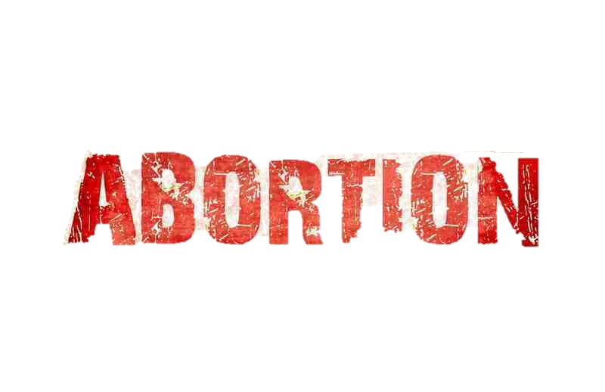
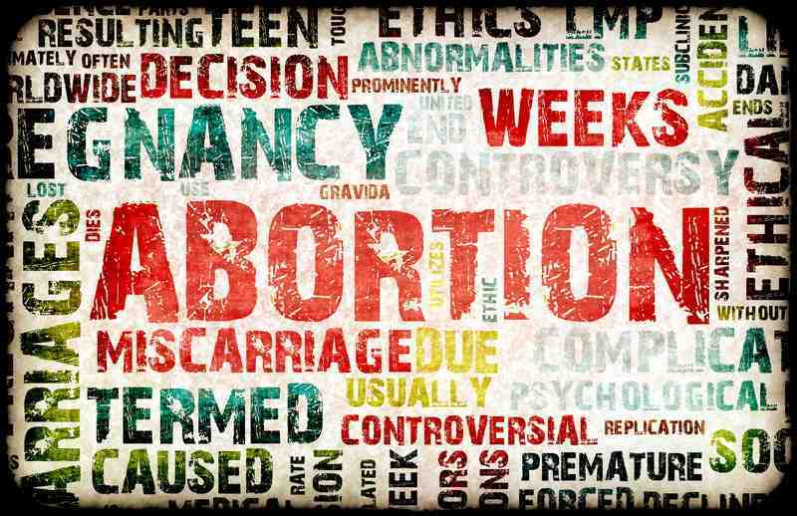

Slide 4
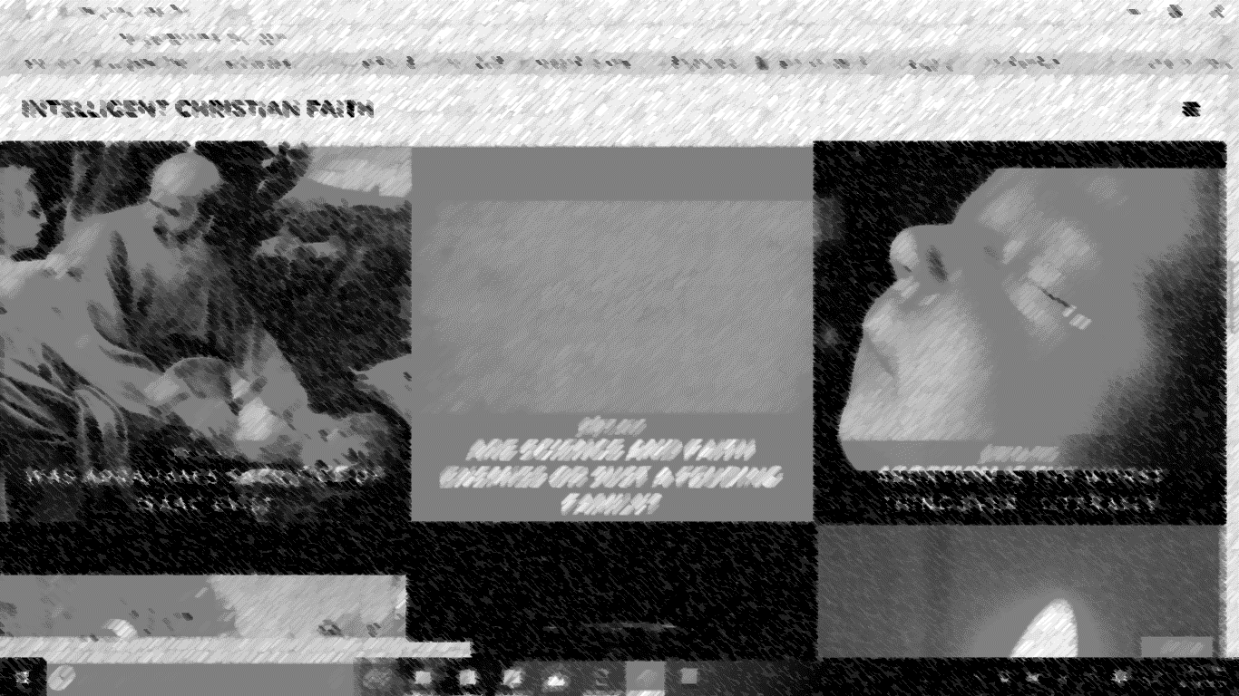
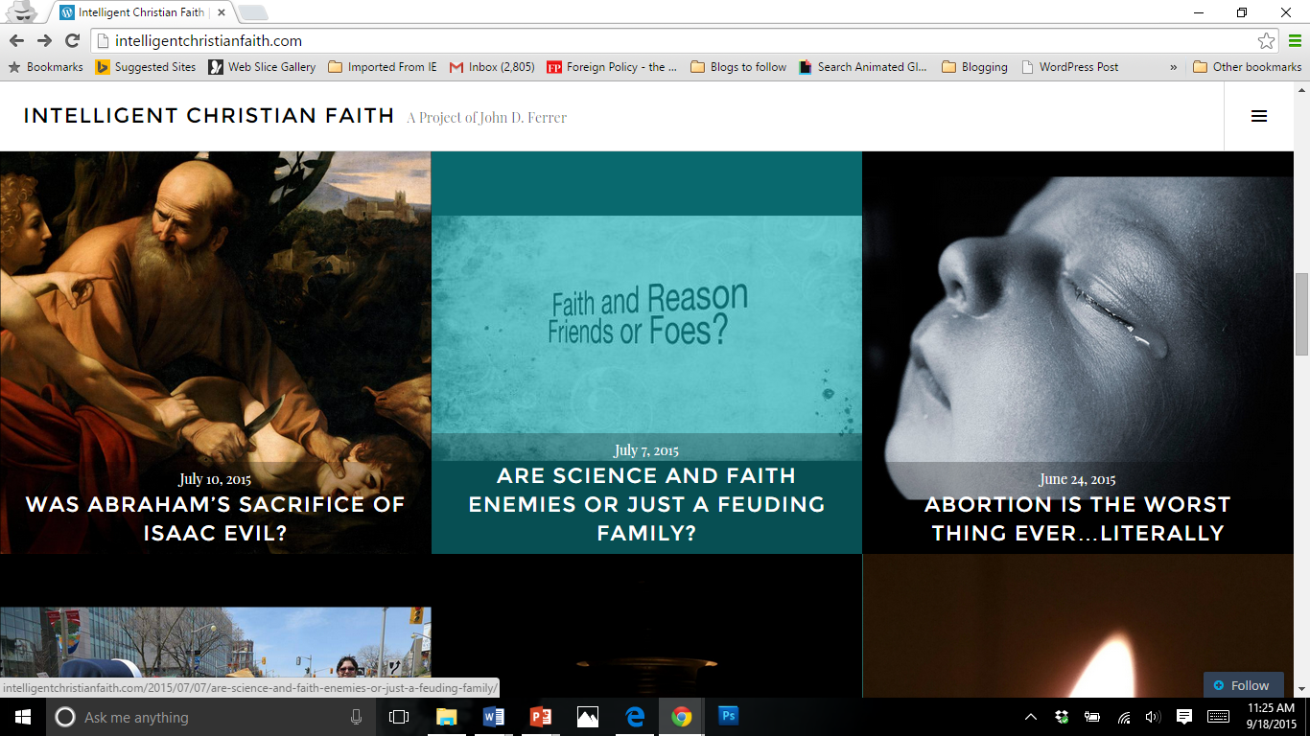
Source: J. Ferrer, “Abortion Is the Worst Thing Ever…Literally,” Dallas, TX: IntelligentChristianFaith.com, 24 June 2015, at: http://intelligentchristianfaith.com/2015/06/24/abortion-is-the-worst-thing-ever-literally/

Slide 5
Since 1973, 58 million U.S. Abortions or...
7,250%> Rwandan Genocide (800,000)
34,000%> Khmer Rouge (1.7mill)
15,700% > Yangtze Flood of 1931 (3.7mill)
6,000-19,000%> Crusades (3-9mill)
9,700%> Holocaust (6mill)
500%> Third Reich (11mill)
117%> Heart Disease&Cancer (1.2mill yearly)
116%> Black Plague (50mill)
Worldwide, there have been 1.35 billion abortions since 1980 or...
1350-2700%> The Flu Epidemic of 1918 (50-100Mill)
5,226%> War Casualties in the 20th Century (258,327,000)
At least 135%> The Great Flood (less than 1Billion).
***Source: J. Ferrer, “Abortion Is the Worst Thing Ever…Literally,” Dallas, TX: IntelligentChristianFaith.com, 24 June 2015, at: http://intelligentchristianfaith.com/2015/06/24/abortion-is-the-worst-thing-ever-literally/***

Slide 6
”Horrible evils can and should terrify us. But their ferocity is only one facet of horror. Perhaps the most terrifying element in large scale evils like war and genocide is their banality. Everyday people abide vicious cruelty with indifference.”
Source: J. Ferrer, “Abortion Is the Worst Thing Ever…Literally,” Dallas, TX: IntelligentChristianFaith.com, 24 June 2015, at: http://intelligentchristianfaith.com/2015/06/24/abortion-is-the-worst-thing-ever-literally/

Slide 7

Ten Tips for Discussing Abortion
1. Remember,“our battle is not against flesh and blood…” (Eph. 6:12)
That person isn’t your enemy
Keep it positive, w/ encouragement and hope.

Slide 8
Ten Tips for Discussing Abortion
2. Address the person over the argument. Care for them.
Use “we” and “us” language
Pray for them as you talk.(And before & after you talk).

Slide 9
Ten Tips for Discussing Abortion
3.Prefer Questions
Discuss, don’t lecture
People love to talk, and want to be heard.

Slide 10
Ten Tips for Discussing Abortion
4. Listen and Learn.
Don’t answer the question, answer the questioner
You can’t do that till you know who you’re dealing with; that means listening.

Slide 11
Ten Tips for Discussing Abortion
5. Dignify their values as your make your case.
Pick your terms carefully.
Ex., “Is it ethical to discriminate against a defenseless human being?” or “Does abortion trade one injustice for another?”

Slide 12
Ten Tips for Discussing Abortion
6. Rephrase prochoice claims in terms of the toll on human life and/or how it violates their own values.
You oppose oppression, so should women be allowed to oppress to the point of killing offspring; Men have no such right?

Slide 13
Ten Tips for Discussing Abortion
7. Ask them to prove, so that there is no reasonable doubt, that the fetal human does not have any right to life and can be justifiably killed through abortion?
(Burden of Proof Argument)

Slide 14
Ten Tips for Discussing Abortion
8. Don’t take the bait on the “personhood” debate
It’s the prochoicer’s responsibility to show that disputes over personhood and “baby” are just cause for killing a human child-in-utero.

Slide 15
Ten Tips for Discussing Abortion
9. Replace euphemisms with precise terminology
Ex.,” Is the fetus a horse fetus, a pig, or a human?”
Ex., Does abortion just terminate a pregnancy—childbirth does that too--or does it terminate a child?

Slide 16
Ten Tips for Discussing Abortion
10. Draw Attention to the Scope of the Problem
Often their logic sounds powerful on small scale, when just one or two tragic cases are in view, but can’t justify 58 million abortions.

Slide 17
Exercises

Slide 18
It’s Her Body, So Her Reproductive Outcomes Should Be Her Choice
2. The Prolife Position Is Misogynistic (Oppressive/Hateful Towards Women)
3. The Prolife Position Restricts Women’s Freedom/Intrudes on Their Right of Privacy
4. Prolifers Are Hypocrites For Supporting The Death Penalty
The Prolife Position Is Unrealistic. It Will Force Women To Get Back-Alley/Coathanger Abortions
6. Prolifers Don’t Care About The Fetus After It’s Born.

Slide 19
What about rape?
What about fetal handicap or deformity?
What about mortally dangerous pregnancies?

Slide 20
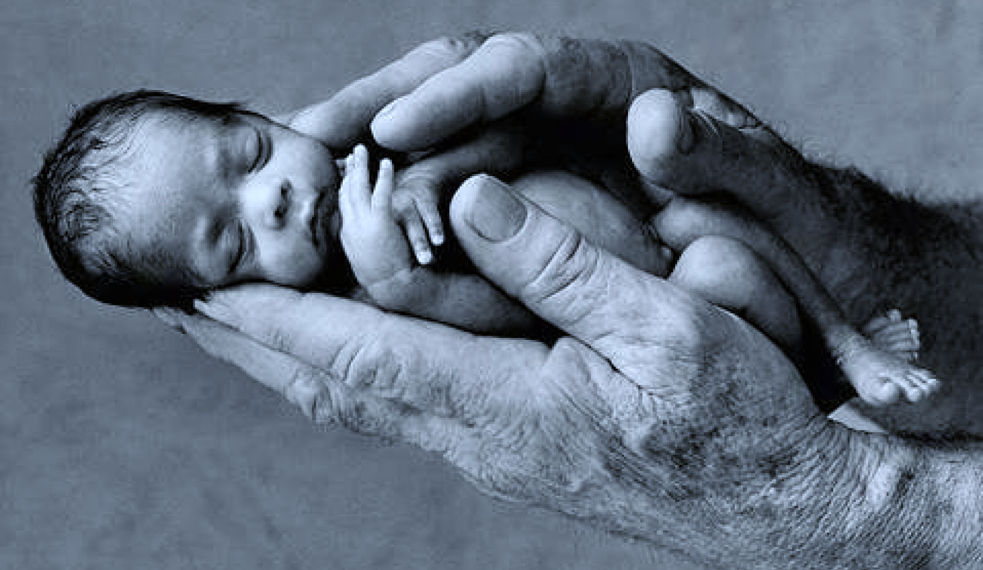
It’s Her Body, So Her Reproductive Outcomes Should Be Her Choice.
Yes and no. Her body is most effected, and privacy isn’t nothing. But it isn’t everything either. Another body is involved and that’s always limited rights of privacy/autonomy
Her body has four arms, four legs, two heads, etc.?
Her body’s immune system attacks the child as a “foreign object”
Regarding Fetal tissue sales, if it’s “her body” then whose limbs and organs was PP selling?

Slide 21
2. The Prolife position is misogynistic (oppressive/hateful towards women).
Quite the opposite, prolifers want every girl baby in utero protected from oppressors who want them dead.
Abortion liberates horny boys to use and abuse women.
Women are mature enough to make “big girl” decisions without the nanny-state sheltering them from all consequences.
Radical feminism and progressivism hurt family, security, affluence, and opportunity for women.
Conflicting views of “womanhood.” Prolifers believe womanhood is not all about casual sex, but also includes wife, mother, daughter of God, etc.

Slide 22
3. The Prolife position restricts women’s freedom/intrudes on their right of privacy.
This is a bit of constitutional gymnastics since the right of privacy is implicit, at best, and nowhere grants human beings the right to kill innocent, non-threatening, family members.
Zero-sum view of freedom: As if my choice entails you will never get to make another choice again. That’s a dangerously mistaken view of freedom/liberty.
Quite the contrary, the prolife position is pro-freedom. Freedom does not normally entail denying another human being all future free choices. Responsible sexuality, mature parenting, and strong families empower freedom and opportunity like nothing else.

Slide 23
4. Prolifers are hypocrites for supporting the death penalty.
So what? If I’m a wretched hypocritic, or a jerk, or an idiot, how does that make it okay to kill our offspring before they get a chance to breath? (Red Herring/Non-Sequitur)
It’s justice to issue capital punishment for a capital crime.
What capital crime have children-in-utero committed?
There have been 1,414 people killed by the death penalty since 1976. Even if every one of those were wrongful deaths, it hardly compares to the 55,595,255 babies killed in the same time (39,318% difference)
http://www.numberofabortions.com/
http://www.christianliferesources.com/article/u-s-abortion-statistics-by-year-1973-current-1042
http://www.deathpenaltyinfo.org/number-executions-state-and-region-1976

Slide 24
5. The Prolife position is unrealistic/It will force women to get back-alley (coathanger) abortions.
If a woman wants to kill her baby, we can’t stop her, but that’s no excuse for helping her do it.
Back when birth control was still a novelty, people thought they had a “hall pass” for casual sex. Now people know better.
Utopian Fallacy: Our reference point is reality, not utopia. We make policies knowing that none of them will be 100% effective.
Kermit Gosnell: Liberal abortion policy hasn’t helped.
History has shown that making things illegal does effect behavior, though the reluctant will never submit (Prohibition).

Slide 25
6. Prolifers Don’t Care About the Fetus After It’s Born.
Prove it. I just don’t believe it.
Tell that to the countless adoption agencies, women’s shelters, adoptive parents, job corps, and charitable organizations that target their services to young struggling mothers.
Red Herring/Non-Sequitur: Even if prolifers were all wretched loveless people, how does that make it okay to kill our offspring before they get a chance to breath? Evil is no cure for evil, nor does injustice fix injustice.

Slide 26
7. What about Rape?
Rape is a horrible crime, but the it’s not the child’s fault.
How should civilized society treat those who remind us of painful events?
Abortion doesn’t undo rape.
Abortion can add another trauma to the already traumatized woman.
Abortion doesn’t subtract one injustice, it adds another.
Abortion accommodates the rapist most of all—making it easier for him to rape again (all his witnesses are silenced since their personal trauma was allowed to determine all the decisions surrounding that rape).

Slide 27
8. What about Mortally Dangerous Pregnancies?
Then it’s not abortion, as such, it’s self defense.
The ethics weigh differently since there’s finally a value offered on the side of abortion comparable to the human life at stake: it’s another human life.
While abortion isn’t demanded here, it’s ethically defensible (in principle) if for example the child has a slim chance of survival and the mother has a strong chance.
However, one can counter that we should still let God take the life and not us—if God wants to claim both lives, or the mother’s life, He has the prerogative.

Slide 28
9. What about Fetal Handicap or Deformity?
This is outright eugenics—we’ve tried that before (1920’s) and it didn’t go well. We lost our stomach for eugenics after Hitler applied it in cold calculated fashion in Germany.
This is playing God—and only God has a right to do that since he’s not playing.
Implicitly denies sanctity of life by replacing it with a “quality of life” rubric instead.
If anything, the handicapped and infirm need more love and care, not less.

Slide 29
How can I get involved?
Get informed.
My sites: https://abortionhistorymuseum.wordpress.com/ and www.intelligentchristianfaith.com
Top Prolife News Site: http://www.lifenews.com/
A Personal Favorite: http://liveactionnews.org/
Just the Fact2: http://www.justfacts.com/abortion.asp.
Speak out
Sign the petitions, discuss, and question. Silence is deadly.
Support Prolife Organizations.
Ex., Online For Life, LifeNews, Texas Right to Life, LiveAction, March for Life, National Right to Life, 40 Days for Life, Pro-life Action League, Life Training Institute, etc.
Help make your church a prolife church.
See: http://intelligentchristianfaith.com/2015/04/21/is-your-church-a-prolife-church/
Make some “home improvements”
Fostering? Adoption? Assist Single Mothers? Parent differently? Etc.

